Slide 1
Types of Communication
CSS SEM 1 Effective Listening

Slide 2
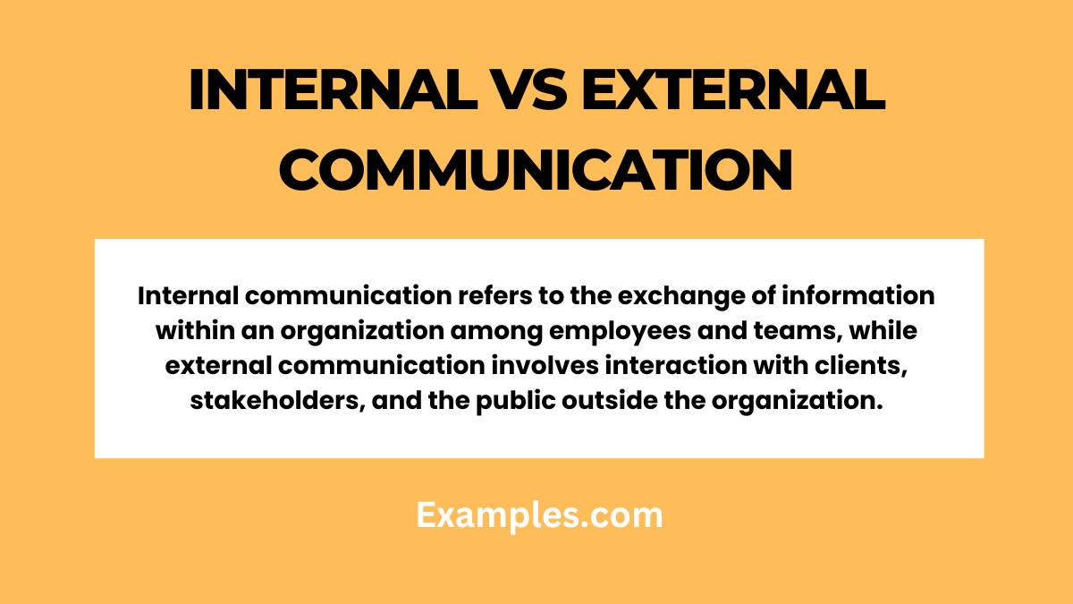

Slide 3
INTERNAL COMMUNICATION | EXTERNAL COMMUNICATION
THE NERVOUS SYSTEM OF THE ORGANIZATION | TH E PUBLIC FACE OF THE ORGANIZATION
Participants : employees, teams, organizational hierarchal positions. | Participants: outside groups, customers, suppliers, vendors, investors, stakeholders, alumni, patrons etc.
Goal : align departments, navigate daily operations, solve problems, boost employees’ morales. | Goal: promote the brand, attract new customers, build reputation, share financial/ legal updates.
Tone: Direct, focused towards problem solving and suggestions. | Tone: polished, carefully crafted, presenting as favorable public image,
Channel: Intranet, organizations’ apps, emails, team meeting, notices, reports | Channel: social media, press release, public website, annual reports, advertisements.

Slide 4
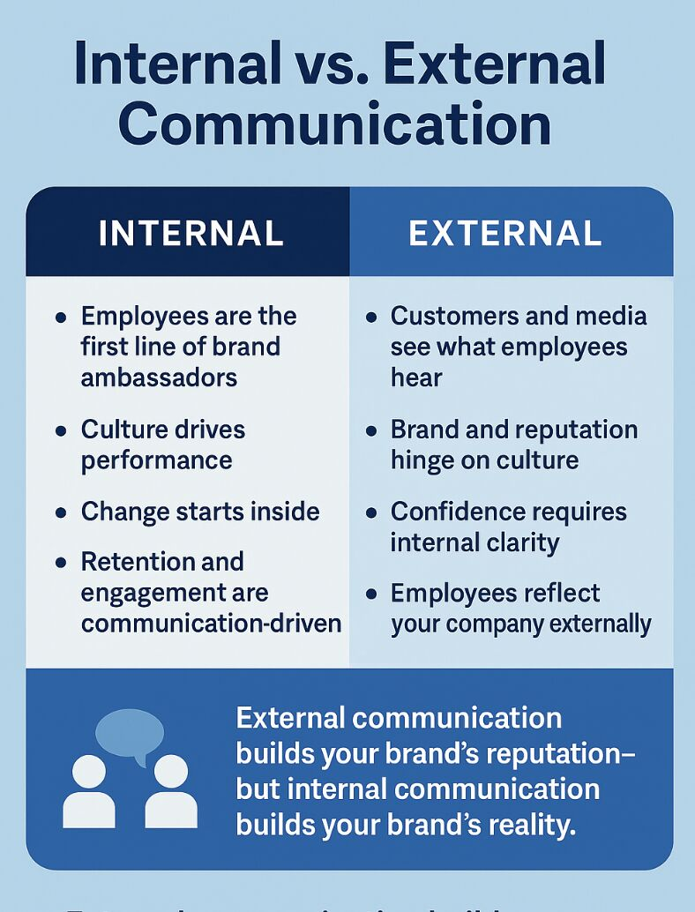
Internal and Exteal Communication

Slide 5
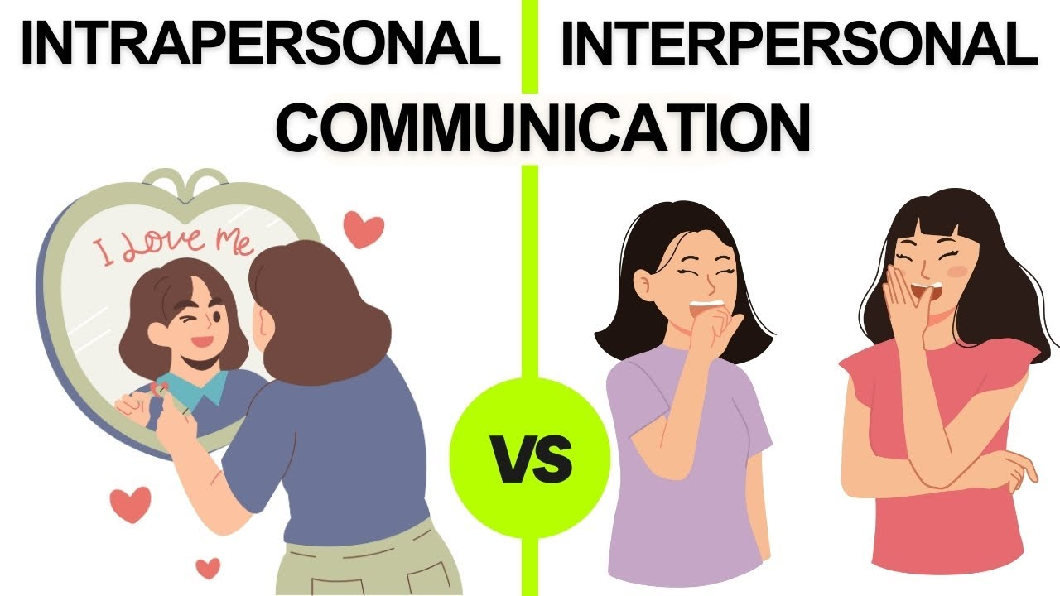

Slide 6
INTRAPERSONAL COMMUNICATION | INTERPERSONAL COMMUNICATION
Occurs within an individual’s mind | Exchange of messages, feelings, ideas between two individuals.
Self talk, meditation, internal dialogue, visualization, memory etc. | Any kind of communication between the two.
Self-reflection, problem solving, emotional regulation, problem solving, decision making, self-motivation, procrastination, self-realization, situation-analysis. | Building and strengthening the relationship. Fostering trust, and growth
Private, subjective and self-directed

Slide 7


Slide 8
ORAL COMMUNICATION | WRITTEN COMMUNICATION
Natural and spontaneous act of communication | Trained act of communication.
Time saving and economic | Time consuming and expensive
Effective for illiterate masses | Ineffective for illiterate masses
Flexible Generates quicker response Lacks evidence value Futuristic value absent | Not flexible No quick response possible Can be preserved as evidences Can be reviewed in future too.

